Slide 1
Omega 3’s and Inflammation
Samantha Jones, Jake Hennen,
Albert Cortez, Brian Lee

Slide 2
Learning Objectives
- Identify the chemical difference between Omega 3 and Omega 6 PUFA
- Understand the role of Omega-3 produced lipid mediators in the inflammation resolution process
-Identify diseases related to chronic inflammation
-Identify the two main beneficial omega 3 fatty acids

Slide 3
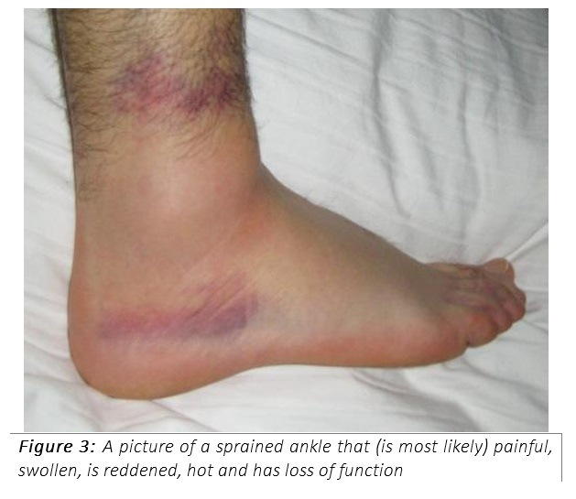
What is Inflammation?
A necessary defensive response to tissue injury or infection
The body’s self-protection mechanism
Begins the healing process
Pain
Redness
Swelling
Heat
http://www.ncbi.nlm.nih.gov/pmc/articles/PMC3428698/#!po=5.00000
http://www.medicalnewstoday.com/articles/248423.php
http://clinicalscienceblogmary.files.wordpress.com/2013/04/3.jpg

Slide 4
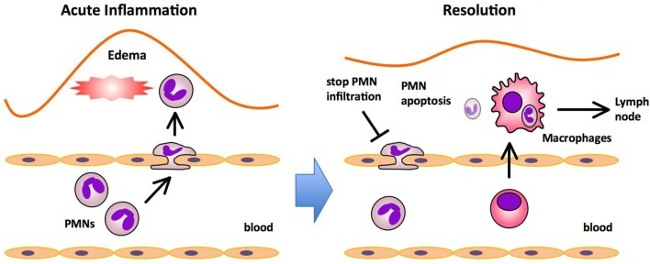
Inflammation Process
Vasodilation
Increased permeability of capillaries
Serum proteins and white blood cells (leukocytes) move from the blood into surrounding tissue
Neutrophils and macrophages enter the extracellular space and begin the process of phagocytosis, “eating” the harmful substances
http://www.ncbi.nlm.nih.gov/pmc/articles/PMC3428698/

Slide 5
Lipid Mediators
Omega 6 derived lipid mediators such as prostaglandins, leukotrienes, cytokines, and chemokines work together to control vascular permeability and leukocytes. This begins the inflammation process
Once the harmful material is removed by phagocytes, the inflammation process must be resolved
Omega 3 fatty acids lead to anti-inflammatory and pro-resolving mediators called resolvins, protections, and maresins.
These mediators encourage the resolution of inflammation by increasing the function of macrophages to clear out products of inflammation (chemokines cytokines, leukotrienes, prostaglandins).
The mediators also reverse the vasodilation and switch off leukocyte activity
http://www.ncbi.nlm.nih.gov/pmc/articles/PMC3652138/
http://www.ncbi.nlm.nih.gov/pmc/articles/PMC3428698/

Slide 6
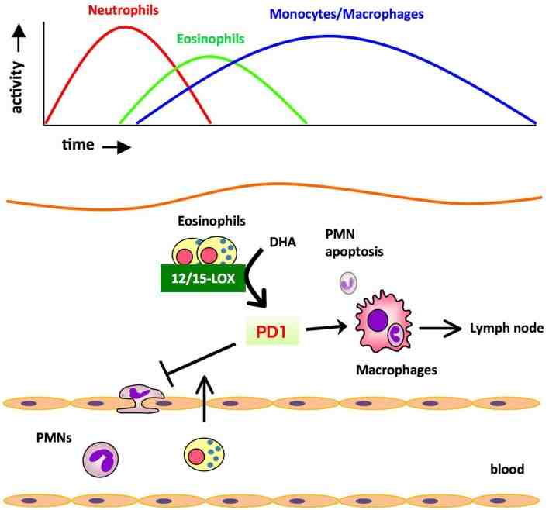
http://www.ncbi.nlm.nih.gov/pmc/articles/PMC3428698/

Slide 7
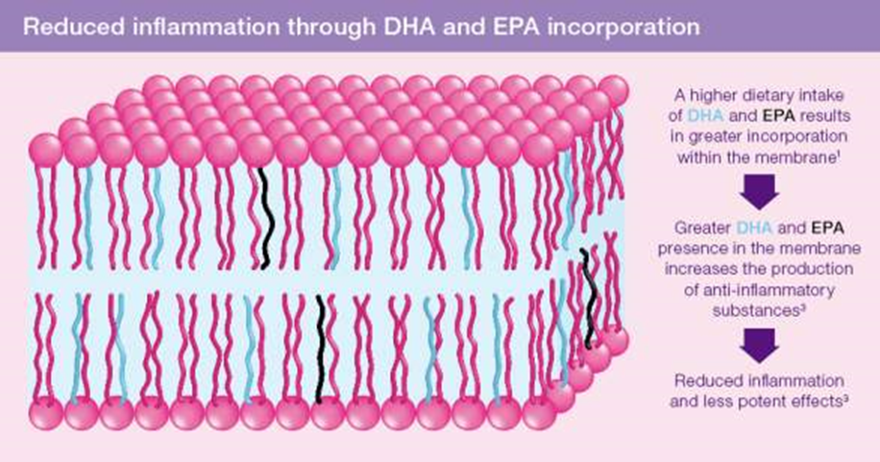
The body stores Omega 3 and Omega 6 fatty acids in the cell membrane to be converted into powerful lipid mediators when needed
http://health.ucsd.edu/news/releases/Pages/2012-05-15-omega-3-oils-help-at-cellular-level.aspx

Slide 8
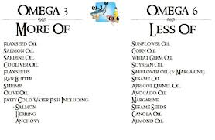
Omega 3 v. Omega 6?
http://www.drweil.com/drw/u/QAA400149/balancing-omega-3-and-omega-6.html
https://umm.edu/health/medical/altmed/supplement/omega6-fatty-acids

Slide 9

You have chosen wisely.

Slide 10
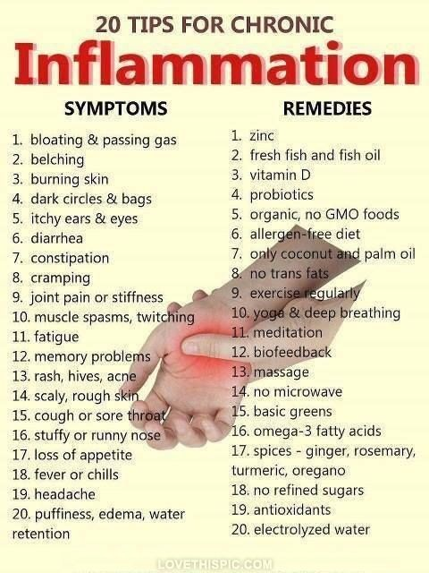
Ignorance is not bliss!
http://media-cache-ec0.pinimg.com/736x/03/d7/2a/03d72a52be1850df15f4a907963f57ce.jpg

Slide 11
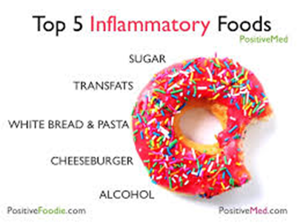
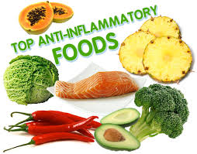
Hey good lookin!

Slide 12
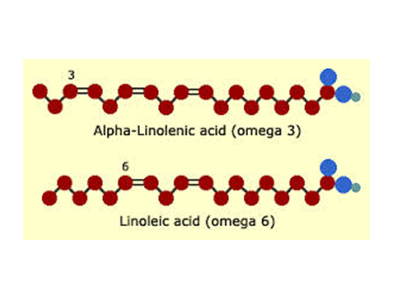
Omega 3 v. Omega 6
1st double carbon bond
1st double carbon bond

Slide 13
Chronic Inflammation and Disease
The incomplete resolution of acute inflammation, leading to chronic inflammation, has been linked to a very long list of diseases, many difficult to treat.
Cardiovascular Disease
Rheumatoid Arthritis
Periodontal Disease
Asthma
Diabetes
Inflammatory Bowel Disease
Alzheimer’s disease
Age-related macular degeneration
Depression
Stroke
Cancer
Pulmonary diseases
http://www.ncbi.nlm.nih.gov/pmc/articles/PMC3428698/
http://www.scientificamerican.com/article/chronic-inflammation-cancer/

Slide 14
Rheumatoid Arthritis
Periodontal Disease
Cardiovascular Disease
Asthma
Cancer
Diabetes
Stroke
Inflammation
Pulmonary diseases
Depression
Age-related macular degeneration
Alzheimer’s disease
Inflammatory Bowel Disease

Slide 15
Some Diseases that Omega 3 can be beneficial for …

Slide 16

Bipolar Disorder (formerly known as “manic-depressive disorder )
Mental illness characterized by episodes of an elevated mood know as mania that is often alternating with episodes of depression.
Prevalence: 4% worldwide
Cause: unknown but possibly linked to:
Biological differences
Neurotransmitters imbalances
Hormonal imbalances
Inherited traits
Environments

Slide 17

Treatments for Bipolar Disorder
Omega 3 has been proven to reduce the symptoms of depression but does not show to be effective on manic outbreaks
Alternative treatments for bipolar disorder is prescribed medication, which are all basically mood controllers
Lithium
Valproic acid
Lamotrigine (Lamictal)
Gabapentin (Neurontin)
Topiramate (Topamax)
Oxcarbazepine (Trileptal)

Slide 18
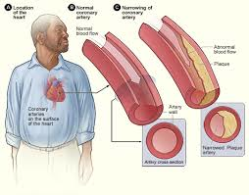
Coronary Artery Disease
Occurs when a substance called plaque builds up in the arteries that supply blood to the heart.
Plaque is made up of cholesterol deposits, which can accumulate in your arteries. When this happens, your arteries can narrow over time. This process is called atherosclerosis.
http://www.cdc.gov/heartdisease/coronary_ad.htm

Slide 19
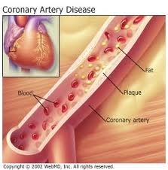
Coronary Artery Disease
Prevalence: leading cause of mortality in USA in both men & women
Nearly 616,000 deaths in 2008 (responsible for 1/4 deaths in U.S.
Approx. 785,000 Americans supper a first heart attack every year.
Causes may includes:
Smoking
Chronic Inflammation
High blood pressure
High cholesterol
Diabetes
Radiation therapy to the chest, as used for certain types of cancer
Symptoms:
Chest Pain (Angina), SOB, Heart attack etc…
://www.mayoclinic.org/diseases-conditions/coronary-artery-disease/basics/causes/con-20032038

Slide 20
Omega 3 and Heart Disease
Benefits of Omega 3 in the diet:
decreased triglycerides
lower blood pressure
reduces blood clotting
decreased risk of stroke and heart failure
reduced irregular heartbeat
Recommended to eat at least two 3.5oz servings of fish a week, or supplement Omega 3.
http://www.mayoclinic.org/diseases-conditions/heart-disease/in-depth/omega-3/art-20045614

Slide 21
Best Treatment
Daily exercise
Good Diet
Low Stress
Quit smoking
High dose Omega 3s are approved by the FDA for treatment of Hypertrilyceridemia (high triglycerides in the blood)
http://www.ncbi.nlm.nih.gov/pmc/articles/PMC3652138/

Slide 22
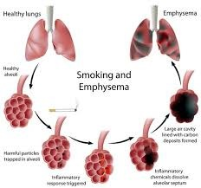
Smoker & COPD
COPD refers to a group of Lung diseases that blocks airflow and make breathing difficult.
Emphysema: Occurs when the air sac (alveoli) at the end of the smallest air passages (bronchioles) in the lungs are gradually destroyed.
Chronic bronchitis: Inflammation of the lining of bronchial tubes, which carry air to and from your lungs
http://www.mayoclinic.org/diseases-conditions/seo/basics/definition/con-20032017
http://www.cdc.gov/mmwr/preview/mmwrhtml/mm6146a2.htm

Slide 23
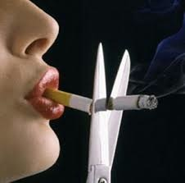
Smoker & COPD
Prevalence: Overall, 6.3% of U.S. adults (an estimated 15 million)
Causes may includes:
Main cause is Tobacco Smoking
About 20% of chronic smokers develop COPD.
Symptoms:
SOB, especially during physical activities
Wheezing & Chest tightness
Having to clear your throat first thing in the morning, due to excess mucus in your lungs
A chronic productive cough
Blueness of the lips or fingernail beds (cyanosis)
Frequent respiratory infections
Lack of energy
Unintended weight loss (in later stages)
http://www.mayoclinic.org/diseases-conditions/seo/basics/causes/con-20032017
http://www.mayoclinic.org/diseases-conditions/rheumatoid-arthritis/basics/symptoms/con-20014868

Slide 24
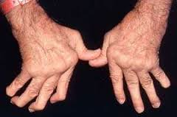
Rheumatoid Arthritis
chronic inflammatory disorder that typically affects the small joints in your hands and feet.
affects the lining of your joints, causing a painful swelling
eventually result in bone erosion and joint deformity.
An autoimmune disorder
Can affect other organs of the body – skin, eyes, lungs, and blood vessels
http://www.cdc.gov/arthritis/basics/rheumatoid.htm
http://www.mayoclinic.org/diseases-conditions/rheumatoid-arthritis/basics/definition/con-20014868

Slide 25
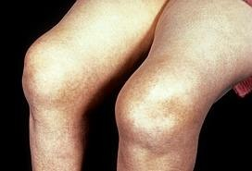
Rheumatoid Arthritis
Prevalence: 0.5% - 1% of general population
Causes: Not 100% clear what causes RA. Triggered by a combination of factors including:
Abnormal Autoimmune reponses
Genetic susceptibility
Environmental or biologic trigger (viral infection or hormonal changes
Symptoms:
Tender, warm, swollen joints (symmetrically)
Morning stiffness that may last for hours
Rheumatoid nodules
Fatigue, fever and weight loss
http://health.shorehealth.org/patiented/articles/what_causes_rheumatoid_arthritis_000048_2.htm

Slide 26
What is the chemical structure difference between Ω3 and Ω6?
A. Omega 3 has only one double carbon bond
B. Omega 3 has three double carbon bonds
C. Omega 6 has six double carbon bonds
D. Omega 3 promotes inflammation
E. None of the above

Slide 27
What is the chemical structure difference between Ω3 and Ω6?
B. Omega 3 has three double carbon bonds

Slide 28
What role do Omega-3 fatty acids play in the inflammation process?
Omega-3 fatty acids produce pro-inflammatory lipid mediators
Omega 3 fatty acids lead to anti-inflammatory and pro-resolving mediators called resolvins, protections, and maresins.
Omega 3 fatty acids have no role in the inflammation process
Omega 3 fatty acids promote chronic inflammation

Slide 29
What role do Omega-3 fatty acids play in the inflammation process?
B. Omega 3 fatty acids lead to anti-inflammatory and pro-resolving mediators called resolvins, protections, and maresins.

Slide 30
Chronic Inflammation has been linked with which disease?
Cardiovascular Disease
Rheumatoid Arthritis
Pulmonary Diseases
Cancer
All of the above

Slide 31
Chronic Inflammation has been linked with which disease?
Cardiovascular Disease
Rheumatoid Arthritis
Pulmonary Diseases
Cancer
All of the above

Slide 32
What are the two main beneficial Omega 3 fatty acids?
DHA / AA
AA / BPA
DHA / EPA
BPA / FDA

Slide 33
What are the two main beneficial Omega 3 fatty acids?
DHA / AA
AA / BPA
DHA / EPA
BPA / FDA

